Slide 1
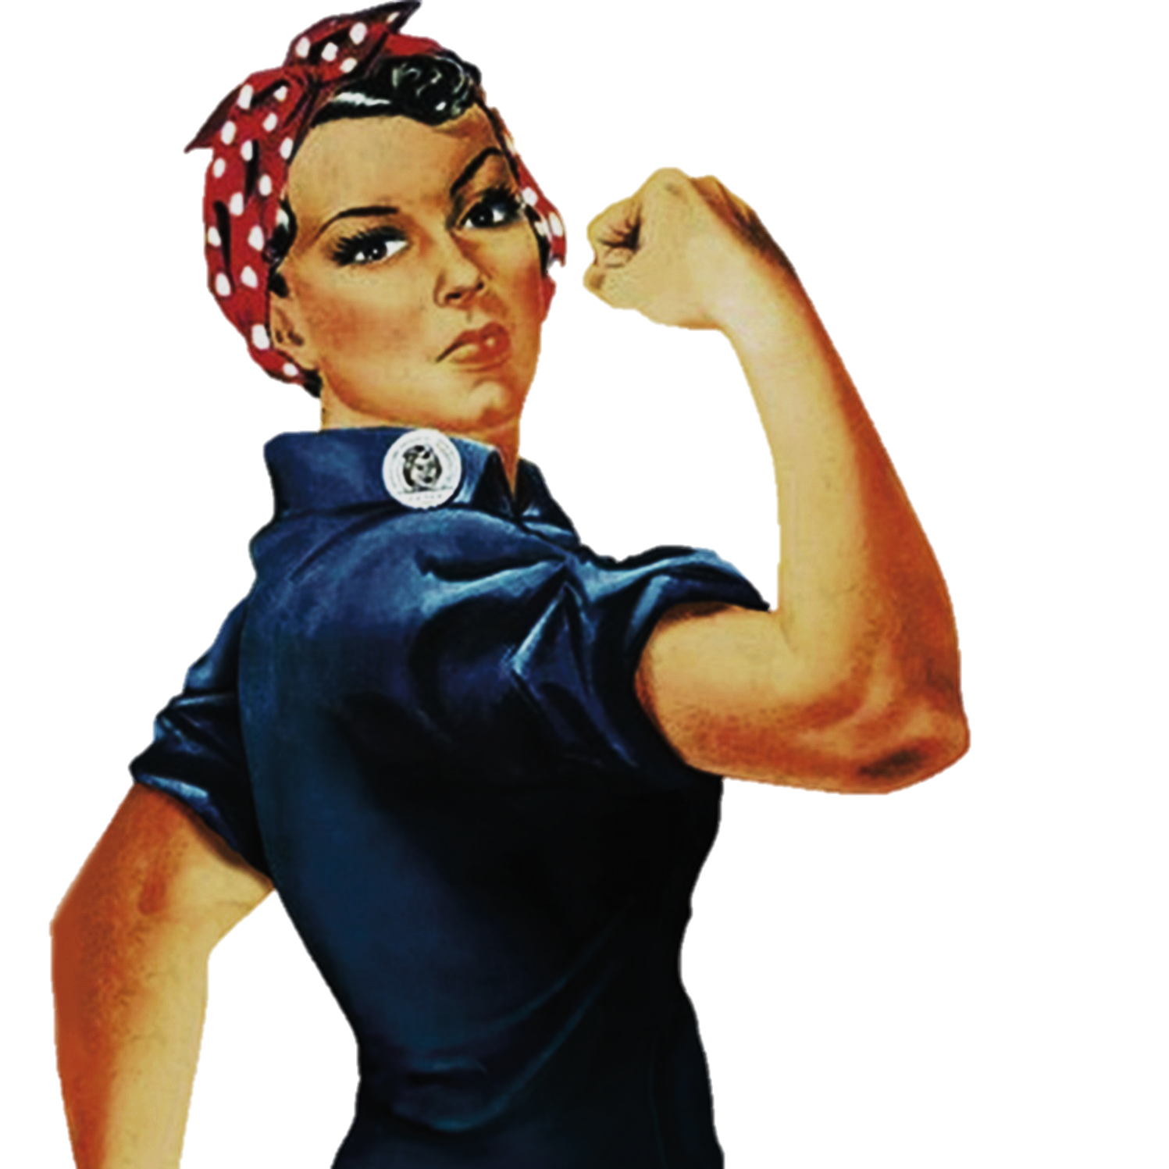
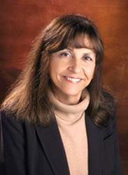

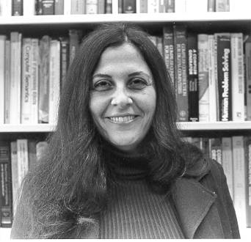
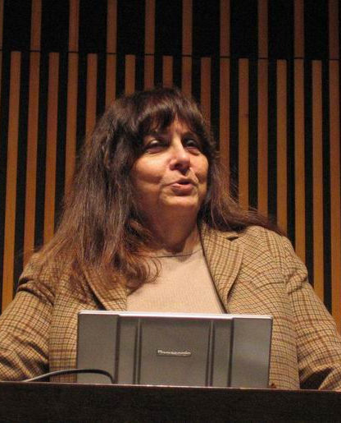
Women
Nancy Leveson
To change pictures:
Save the picture of the person you wish to use.
Single-left-click the grouped picture/shapes you wish to change on the poster. Single-left-click again on the picture.
Now single-right-click the picture and select “Change Picture” from the menu.
Choose the picture file you saved.
You may wish to single-left-click the grouped picture/shapes and single-left-click the new picture again to adjust its size or crop it—especially useful if the new picture is not the same aspect ratio as the previous one.
DO NOT CHANGE ROSIE THE RIVETER PICTURE!!!
In Technology
1980 Ph.D. Computer Science
1999 MIT Professor
Editor of the journal IEEE Transactions on Software Engineering
Studied aircraft collision-avoidance systems and radiation therapy machines
Started a new area of research, software safety, which is concerned with the problems of building software for real-time systems where failures can result in loss of life or property.
Prof. Leveson conducts research on all aspects of system safety including design, operations, management, and social aspects and consults extensively in many industries, including aerospace, transportation, chemical plants, medical devices, nuclear power, hospitals, and oil and gas production.
What paths will you trailblaze that no one has traveled before?

